Slide 1
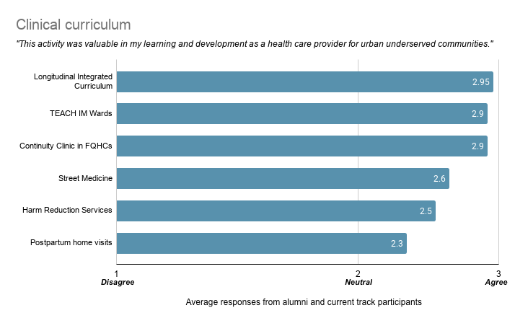
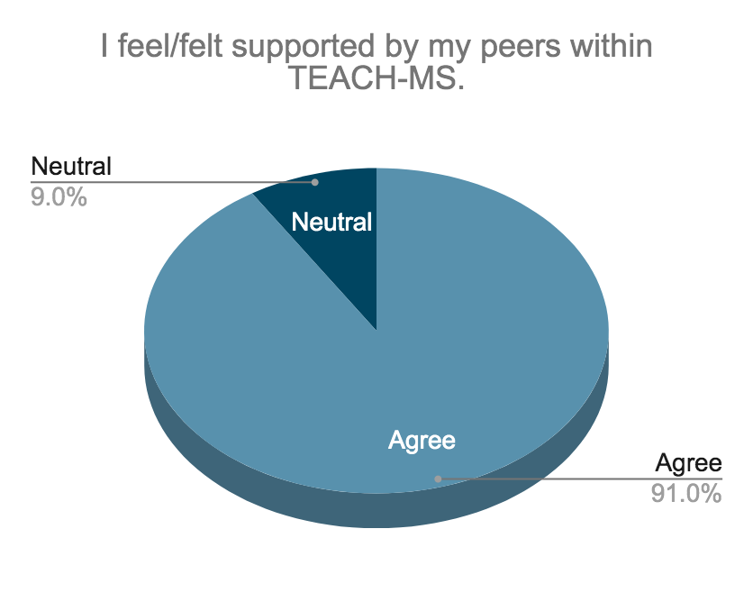
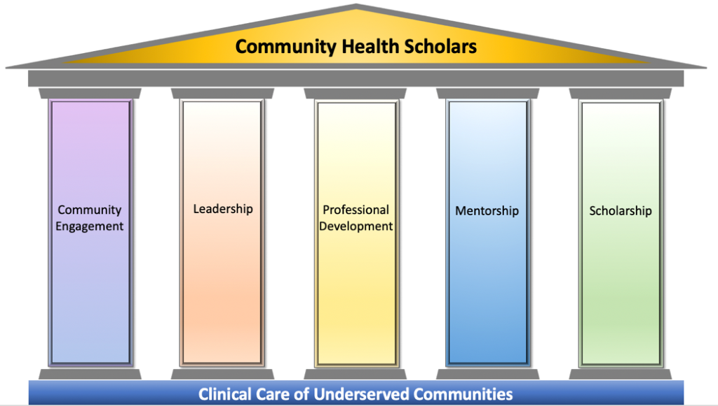
Preparing future providers to care for urban underserved communities:
An evaluation of the TEACH-MS curriculum at UC Davis School of Medicine
Theo Yonn-Brown¹, Esther Kang¹, Melody Tran-Reina, MD¹
¹ UC Davis School of Medicine
BACKGROUND
METHODS
RESULTS
CONCLUSIONS
The Transforming Education and Community Health for Medical Students (TEACH-MS) was created in 2011 and designed to be a “four-year tailored M.D program at the UC Davis School of Medicine for students with a strong interest in primary care for the urban underserved.”¹ As of February 2021, 31 alumni have participated in the TEACH-MS track program. However, there has not yet been a holistic evaluation of the impact of the curriculum in preparing future physicians to care for urban underserved communities. The urgency for this investigation is also compounded in the setting of major overarching curricular changes at UC Davis School of Medicine.
There are elements of the current TEACH-MS curriculum that have been previously studied in wider academic research. Most notably, the longitudinal integrated clerkship (LIC), which has historically been the pillar of TEACH-MS students’ clinical years, is a structure that has been shown to cultivate patient centeredness, enhance learning relationships, and promote increased exposure to common social and health issues.² However, other elements utilized in the TEACH-MS program, such as didactics and community projects, have previously shown to have variable outcomes in cultivating physicians’ capacity for social action.³
Given that it has been a decade since the formation of the TEACH-MS track program, we believe that it is a critical time to assess and reflect on the program’s curriculum and direction. We hope that this project will serve as an opportunity to identify the strengths of the TEACH-MS track program and provide recommendations for curricular refinements.
To achieve the aims of the project, we utilized a mixed method approach. The primary component of the project involved a survey tool, which utilized a standard scale to quantify the experiences, value, and satisfaction of former and current track participants. We surveyed participants about general and specific aspects of the TEACH-MS curriculum in achieving program objectives (preclinical curriculum, clinical curriculum, social support). A qualitative portion of the questionnaire was also used to identify prominent themes of both strengths, areas for improvement, and desired skills and experiences. The electronic survey was disseminated to participants through email. Electronic data collection occurred between November 2020 and January 2021. Participation in the survey was voluntary and anonymous.
A focused interview⁴ was then conducted with the current fourth year medical students to expand upon critical topics identified by the aforementioned survey. The fourth year class was chosen as they have most recently completed all of the components of the current track curriculum. Responses to interview questions were not linked to the participants’ identities.
Data analysis
Survey responses from the non-continuous categorical survey data collected were used to create summative scales across survey groups; additionally they were combined to form an overall mode for each component of the questionnaire. From the perspective data collected, prominent themes were identified and enumerated by the popularity of named perspectives. In the focused interview conducted there was a saturation of opinion⁴ surrounding the prompt given to the participants.
31 total unique survey responses were collected. 74% of current track students (n = 20) completed the survey. 41% of alumni (n = 13) completed the questionnaire.
Curricular components Pre-clinical curriculum: Participants rated the Summer Institute on Race and Health, and pre-clinical exposure to patient care at FQHCs as the most valuable activities to their learning and development.
Clinical Curriculum: Participants identified the 3rd year LIC as the most valuable activity. It is important to note that the LIC is currently suspended. Other highly rated activities (Harm Reduction Services, street medicine, postpartum home visits) are also now suspended as they were individual components within the LIC.
Overall program value:
While popular responses to this portion of the survey spanned pre-clinical and clinical components of the program, participants found the community and peer support within TEACH-MS to be its most valuable attribute.
Desired learning experiences
Skill-sets: The skills that participants identified as being important to working with an urban underserved community were unified around the items listed in the table below. Cultural humility, a concept taught during the Summer Institute on Race and Health, was the skill that was repeated most often.
Exposure: Many vulnerable communities were represented in the answers given by students and alumni. The top five are shown in the table below.
This project was a preliminary effort to evaluate the impact of the TEACH-MS track program. Notable strengths of the track program included strong peer support and high satisfaction with core elements of the curriculum (e.g. Summer Institute on Race and Health, TEACH IM Wards, experiences in FQHCs, and LIC). Alumni remarked that the program was a “great building block” that “created more awareness and a wanting to learn more.” Numerous participants, however, stressed that more robust institutional resources and administrative support are needed to continue building the track program.
This was a largely qualitative study based on the perspectives of alumni and current medical students. Additionally, while the current curriculum has overarching themes for each year (see Table 1), it lacks learning competencies⁶; this limited the identification and measurement of outcomes in this study. The formation of learning competencies is currently under development.⁷ We recommend further follow-up evaluations once these measurable learning outcomes are implemented.
Curricular recommendations based on findings:
Implement a backwards-planned, outcomes-driven curriculum (forthcoming, see Image 1).^{6,7}
Embed evaluations throughout medical school and after graduation to measure progress on learning competencies and program satisfaction.
Engage in conversations about re-implementing LIC.
Re-integrate activities with community partners, which was a core component of LIC.
Consider a fourth year program component to reaffirm values and hone leadership skills. Possibilities include a capstone didactic or a clinical elective.
Urban communities are immensely diverse and have unique and evolving healthcare needs. We strongly support the continuation of the TEACH-MS track to develop compassionate and excellent urban providers, and believe its reach and impact can be furthered with more financial resources and regular evaluations.
Table 1: Overarching aims of TEACH-MS Curriculum
Orientation: Introduce students to the TEACH-MS curriculum and prepare students for work in the community. Year 1: Exposure to local community through clinical engagement opportunities Summer between year 1 and 2: Intensive 4 week course to reflect on issues of identity, power imbalances, and the historical contexts that can result in disparities in both health status and health-care delivery Year 2: Building on Year 1 community experiences and applying what was learned during Institute. Year 3: Students will spend the majority of their core rotation experiences at facilities serving urban underserved patients in Sacramento and surrounding communities. Year 4: Fourth year students are encouraged to contribute to the TEACH-MS program through curriculum and admissions opportunities.
Inclusion criteria | Exclusion criteria
Currently enrolled TEACH-MS medical students. Matriculated alumni of the TEACH-MS program. | TEACH-MS students who have attended less than 180 days of medical school. Current medical students who left the track program prior to the completion of medical school.
Table 2: What has been or was the most valuable or impactful component of TEACH-MS?
Peer support and community TEACH wards Community partnerships Summer Institute
“Having other students who were like-minded and equally passionate about serving urban underserved population was the best part of the program.“
– Alumni
Image 1: The 5 Pillars of Excellence. The forthcoming groundwork for the TEACH-MS track’s learning competences.⁷
PROJECT OBJECTIVES
What are the top 3 skill-sets you think graduates of the TEACH-MS should have by the end of medical school? | What are the top 3 communities that you would like to be exposed to as a participant of TEACH-MS?
Top repeated responses: Cultural humility Navigating community resources for patients Advocacy for patients and for institutional changes Assessing and addressing social determinants of health Building community partnerships Comfortability in urban clinical settings Fostering leadership skills | Top repeated responses: Uninsured and underinsured Immigrants, refugees, patients who are undocumented, migrant workers Individuals experiencing homelessness Medically underserved communities of color Individuals struggling with addiction
#1: Assess the alignment of the current TEACH-MS curriculum with the established program mission and objectives, as experienced by TEACH-MS students and alumni.
#2: Use above results to report on program learning competencies and provide recommendations for the pre-clinical activities, community building, and clinical experiences.
REFERENCES
About TEACH-MS.| UC Davis School of Medicine. https://health.ucdavis.edu/mdprogram/TEACH-MS/overview.html. Accessed February 11, 2021.
Strasser R, Hirsh D. Longitudinal integrated clerkships: transforming medical education worldwide? Medical Education. 2011;45(5):436-437.
Sharma M, Pinto AD, Kumagai AK. Teaching the Social Determinants of Health. Academic Medicine. 2018;93(1):25-30.
Morse, J. M. (1994). Designing funded qualitative research. In Denizin, N. K. & Lincoln, Y. S., Handbook of qualitative research (2nd Ed). Thousand Oaks, CA: Sage.
TEACH-MS Curriculum | UC Davis School of Medicine. https://health.ucdavis.edu/mdprogram/TEACH-MS/curriculum.html. Accessed February 11, 2021
Prideaux D. ABC of learning and teaching in medicine: Curriculum design. BMJ. 2003;326(7383):268-270.
Tran-Reina, M. Draft of UC Davis School of Medicine Community Health Scholars (CHS) Curriculum. 2021.
“I'm an MS1 learning in the isolated COVID19 era. The community saved my sanity. “

