Slide 1
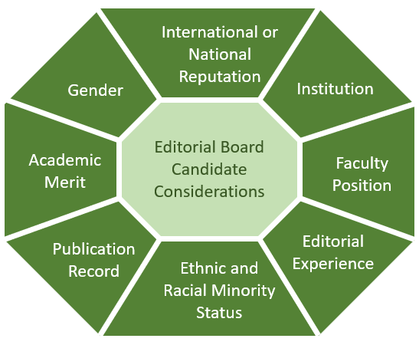
Diversity in Journal Editorial Review Boards in Psychiatry and Neuroscience
Erika Cristina Monterroza¹, Ruth Shim M.D., M.P.H², Laura Tully P.H.D.³, Mary Blandermann⁴
Department of Psychiatry and Behavioral Medicine
Medical Student Scholarly Project, UC Davis School of Medicine
Introduction
References
Methods
1. Mindt M.R., Hilsabeck R.C., Olsen J. P., Savin M.J., Crook C.L., Suchy Yana. Advancing Science through Diversity and Inclusion in the Editorial Process: A Case Study Strategies. Science Editor, 2018; 41(3):93-96
2. Amrein K., Langmann A., Fahrleitner-Pammer A., Pieber T.R., Zollner-Schwetz I. Women underrepresented on editorial boards of 60 major medical journals. Gender Medicine. 2011 December; 8(6);378-87
3. Erren T.C., Gross J.V., Shaw D.M. Representation of Women as Authors, Reviewers, Editors in Chief, and Editorial Board Members at 6 General Medical Journals in 2010 and 2011. JAMA Internal Medicine. 2014;174(4):633-635
4. Jagsi R., Tarbell N.J., Henault L.E. The Representation of Women on the Eidtorial Boards of Major Medical Journals: A 35-Year Perspective. Archives of Internal Medicine. 2008; 168(5):544-548
5. Keiser J. Utzinger J, Tanner M. Singer B.H. Representation of authors and editors from countries with different human development indexes in the leading literature on tropical medicine: survey of current evidence. British Medical Journal. 2004 May 22;328(7450):1229-32
6. Tutarel O. Composition of the editorial boards of leading medical education journals. BMC Medical Research Methodology. 2004 January 20;4:3.
7. Keiser J. Utzinger J. Singer B.H. Gender Composition of editorial boards of general medical journals. The Lancet. 2003 October; 362(9392)
Previous research examining the diversity and inclusion of editorial review boards has revealed that the participation of women in editorial boards of major medical journals is extremely underrepresented. One analysis of women on editorial boards of major medical journals found that only 15.9% of the major medical journals that were investigated had editors in chief that were women. Also, less than one fifth of all editorial board members were women (Amrein et al, 2011).
Although there are many studies investigating gender diversity of editorial boards, no previous research has examined participation of people from racial groups that are underrepresented in medicine (URM). Lack of representation as editors-in-chief and on editorial boards leads to bias and a lack of adequate scientific quality in these journals, as evidenced by recent publication of content in the journal Neurology that was universally recognized as being racist and discriminatory.
Participants include editors-in-chiefs of peer reviewed psychiatry and neuroscience journals as well as mental health professionals. Editors-in-chief of major psychiatry and neuroscience journals were identified via database search and were contacted via email. Mental health professionals in the fields of psychiatry and neuroscience were identified through health professional list-serves.
A survey tool consisting of questions directly asking the participant about current editorial board role, editorial review board demographics and editorial board recruitment processes was created. The survey investigates specifics about strategies employed to encourage recruitment of diverse editorial review boards (Figure 2). The survey tool also asks about overall editing experience of the participants in the fields of psychiatry and neuroscience.
The data from the survey will then be statistically analyzed to quantify demographics of major psychiatry and neuroscience editorial review boards. Open ended questions will be analyzed to standardize recruitment processes of editorial boards and identify which major strategies (if any) for diversification and inclusion of editorial review boards are being employed across these fields of medicine.
Which of the following policies has the journal enacted to address considerations related to diversity and inclusivity of the editorial board’s recruitment process?
Established a Gender and Culture Department and appointed experts on gender and cultures to help identify potential qualified board members.
Presented at journal society meetings to educate members about editorship.
Encouraged individual members to reach out to potential board members who are women or from culturally and/or racially diverse backgrounds.
Announced policy changes on the journal website and/or social media platforms
Practiced sustained commitment to diversity to obtain serious “buy-in” from individuals of all backgrounds.
Taken advantage of educational opportunities regarding diversity.
Objectives
To examine the gender and underrepresented minority in medicine (URM) demographic makeup of Editorial boards of US Psychiatry and Neuroscience Journals and select editorial boards of global Psychiatry and Neuroscience Journals.
Ascertain editorial board member recruitment processes as it pertains to gender and underrepresented minority in medicine diversification and inclusion.
We hypothesize that underrepresented groups in medicine rarely serve on editorial boards due to a complex set of poorly understood and unaddressed barriers.
Figure 2. Recommendations for increasing diversity and inclusion in the editorial process (Mindt et al.¹)
Investigational Questions
Results and Discussion
To date, the survey will be launched in March 2020 and preliminary results are currently being collected. Although we can hypothesize that results from the survey will reveal demographic composition of editorial boards in psychiatry and neuroscience journals to be lacking in URM and women, we are also interested in analyzing responses related to recruitment strategies of new board members as well as how diversity and inclusion are considered at large.
We expect this information to provide us insight into the variability of strategies employed by different journals to recruit new members for the review of their articles to be published so that we may provide a deeper understanding of how the academic and clinical research community build and shape medical science and the practice of medicine.
Future Considerations:
Collection and statistical analysis of survey responses with publication of research article.
Further investigation into this subject may include determination of influence of editorial board demographic composition on journal author and article topic selection.
What does “Underrepresented in Medicine” mean?
Acknowledgments
Races and ethnicities underrepresented in medicine are defined by the AMA as “those racial and ethnic populations that are underrepresented in the medical profession relative to their numbers in the general population”. Currently, this definition encompasses those who identify as African American and/or Black, Hispanic/Latino, Native American (American Indian, Alaska Native, and Native Hawaiian), Pacific Islander, and mainland Puerto Rican.
Ruth Shim, M.D., M.P.H.
Luke & Grace Kim Professor in Cultural Psychiatry
Director of Cultural Psychiatry, Department of Psychiatry and Behavioral Sciences
Associate Professor, Department of Psychiatry and Behavioral Sciences
Figure 1. How are the following considerations weighted when considering new candidates for membership on the editorial board?

