Slide 1
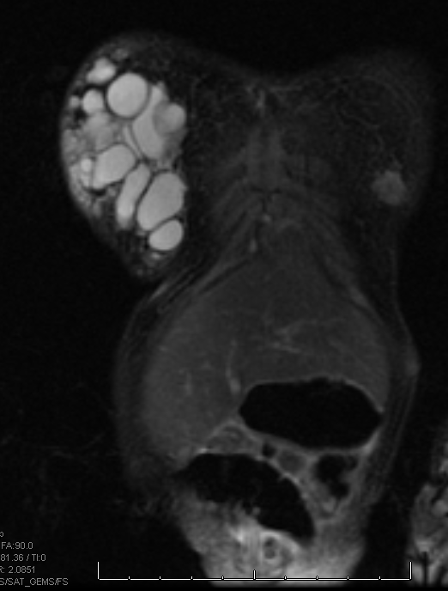
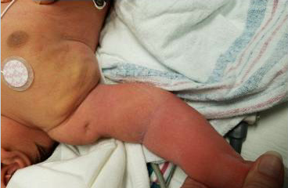
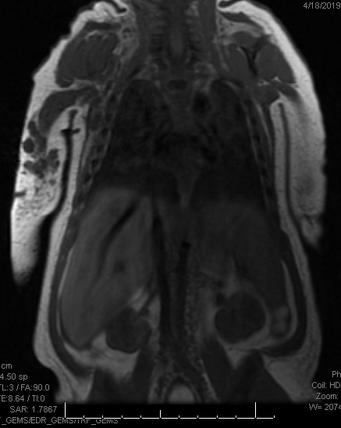
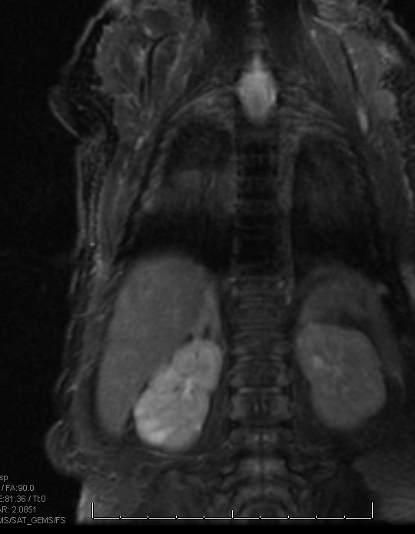
Chest Wall Mass in a Newborn Infant
Brenda Tran Wu¹, BS, Rebecca Stein-Wexler², MD, Su-Ting Li³, MD, MPH
UC Davis School of Medicine¹, UC Davis Department of Radiology², UC Davis Department of Pediatrics³
INTRODUCTION
Imaging studies:
  Ultrasound: 6cm x 1.7cm fluid collection, undulating borders
  CXR: mild cardiomegaly
  MRI: multiple loculated, fluid-filled cysts in the superficial right chest wall and in the right arm extending into the right forearm, multiple fluid-filled cysts in bilateral kidneys and 1 in the mediastinum → presumptive diagnosis of lymphangiomatosis
Laboratory studies:
  Rapid genome sequencing: de novo pathogenic variant of PKD1 mutation; 2q13 microdeletion of unknown significance
CLINICAL IMAGES
CONCLUSIONS & RECOMMENDATIONS
Lymphatic malformation (LM):
Congenital vascular anomaly of the lymphatic system, characterized by multiple intercommunicating cystic spaces with lymphatic fluid
Affects 1 in 2000-4000 live births (1)
Can affect any part of the body
Diagnosed prenatally during routine ultrasound in the late 2nd-3rd trimesters, at birth, or in early childhood with MRI
We describe a case of simultaneous LM and de novo autosomal dominant polycystic kidney disease 1 (ADPKD1).
MRI is essential when an extensive lymphatic malformation is suspected, since ultrasound often underestimates deep or intracavitary involvement.
Imaging can help distinguish ADPKD from renal lymphangiomatosis (RL), since PKD lesions are more parenchymal and peripheral than the central lesions typical of RL.
Specialists to involve in the care of a patient with lymphatic malformation include geneticists, surgeons, interventional radiologists, nephrologists, dermatologists
Sclerotherapy should be considered for patients with lymphatic malformations
Coronal T2 MRI
weighted fat saturated image delineates the lesion in the right anterior chest wall, consisting of hyperintense lobulations with thin hypointense septations.
INITIAL PRESENTATION
DIAGNOSIS
REFERENCES
Diagnosed with lymphatic malformation and PKD1. Initially unclear whether one or both processes affecting kidneys, especially knowing PKD1 typically presents in adulthood (2).
Further evaluation of MRI of renal cysts found they were peripheral, parenchymal – more typical of ADPKD than renal lymphangiomatosis (central, renal sinus cysts) (4).
Treatment options: sclerotherapy, surgery, sirolimus (for diffuse lymphangiomatosis), radiotherapy (3).
Defnet, A.M., Bagrodia, N., Hernandez, S.L. et al. Pediatric lymphatic malformations: evolving understanding and therapeutic options. Pediatr Surg Int 32, 425–433 (2016).
Vujic M, Heyer CM, Ars E, et al. Incompletely penetrant PKD1 alleles mimic the renal manifestations of ARPKD. J Am Soc Nephrol. 2010;21(7):1097–1102.
Laforgia N, Schettini F, De mattia D, Martinelli D, Ladisa G, Favia V. Lymphatic Malformation in Newborns as the First Sign of Diffuse Lymphangiomatosis: Successful Treatment with Sirolimus. Neonatology. 2016;109(1):52-5
Kashgari A, Ozair N, Zahrani A, et al. Renal lymphangiomatosis, a rare differential diagnosis for autosomal recessive polycystic kidney disease in pediatric patients. Radiology Case Reports. 2016.
Coronal T1 MRI
weighted image shows the hypointense multilobulated lesion in the superficial hyperintense adipose tissue of the right upper arm. The renal lesions are less evident.
PATIENT COURSE
2 day old, ex-term, large for gestational age male presents from an outside hospital for evaluation of a right chest wall mass. Mother is a 33yo G4P4, good prenatal care, uncomplicated pregnancy, elective cesarean delivery.
Physical exam:
  Boggy, fluctuant, flesh-colored, grape-like mass from his right nipple to midaxillary line that extends to the right upper arm
  Dimpling of the skin throughout the right upper extremity
Referred for sclerotherapy after multidisciplinary evaluation on initial admission → lost to follow up
5 months later, presented with cough and pallor → diagnosed with parainfluenza w/ CXR showing airway compromise due to mass enlargement → admitted for 20 days. Procedures performed:
  Percutaneous drainage of dark, sanguineous fluid
  Bleomycin sclerotherapy x 2 (1.5 months apart)
CXR: smaller mass and improved R lung expansion
Persistently elevated blood pressure, treated with enalapril
Renal ultrasound: enlarging right cyst and new left cyst
Coronal T2 MRI
weighted fat saturated image shows there are multiple sub-cortical hyperintense renal lesions, most numerous on the right.
CONTACT
Brenda Wu, MS4
MD Candidate Class of 2020
UC Davis School of Medicine
brendawu223@gmail.com

