Slide 1

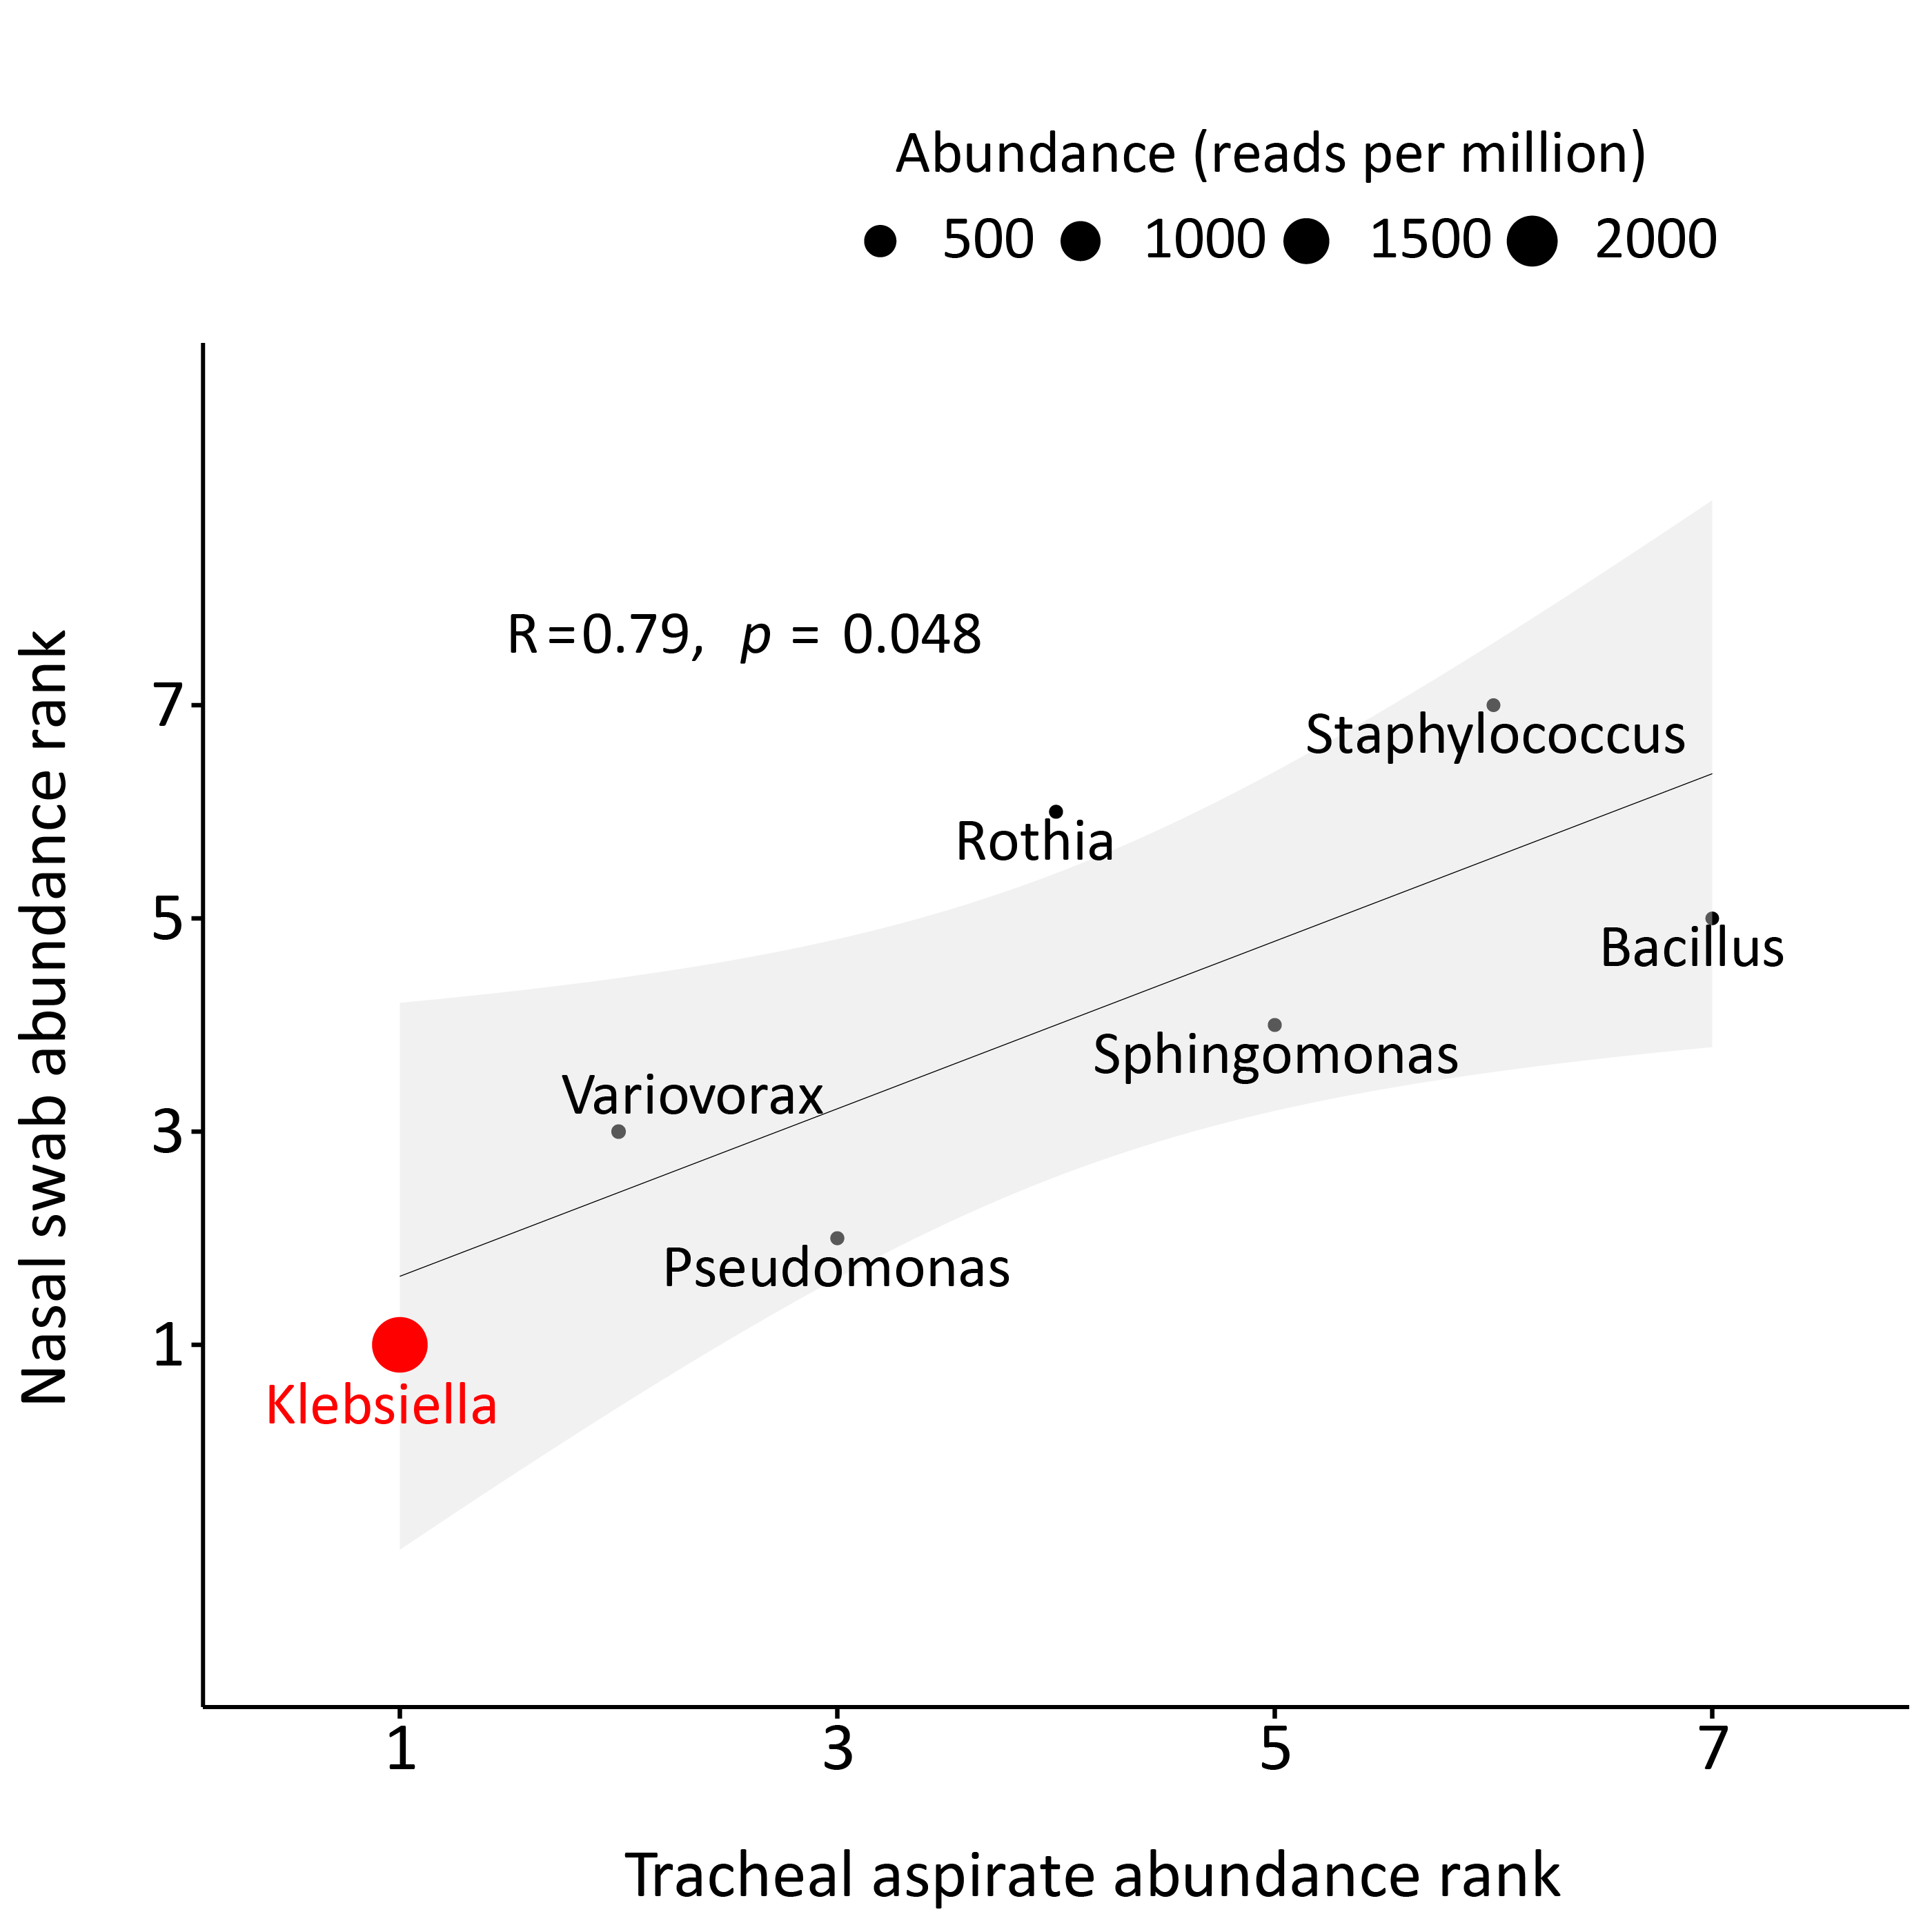
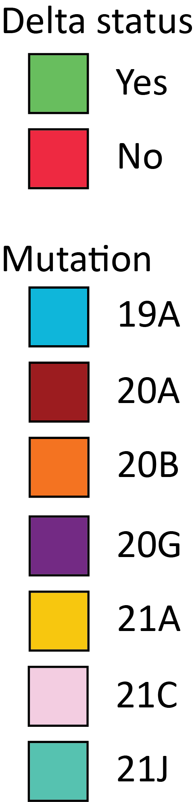
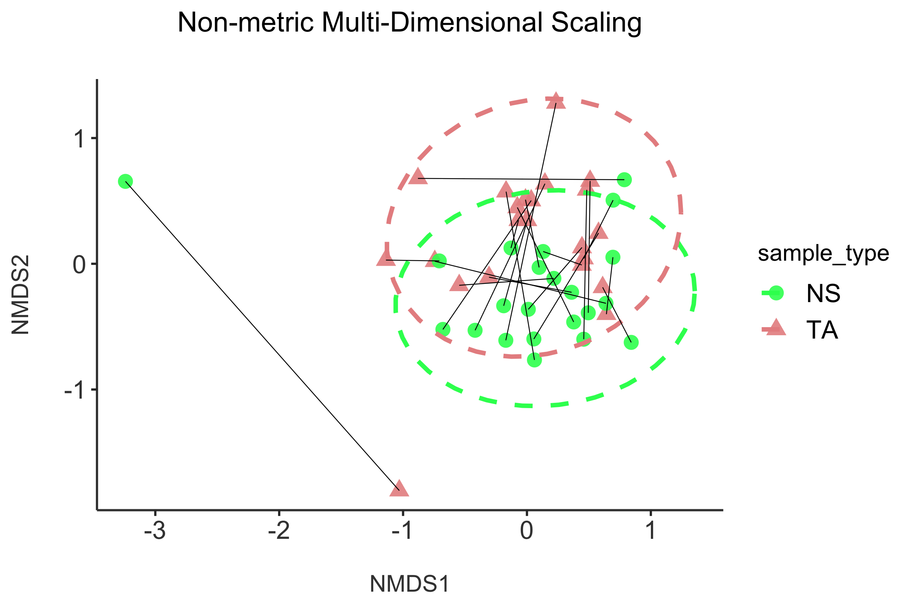
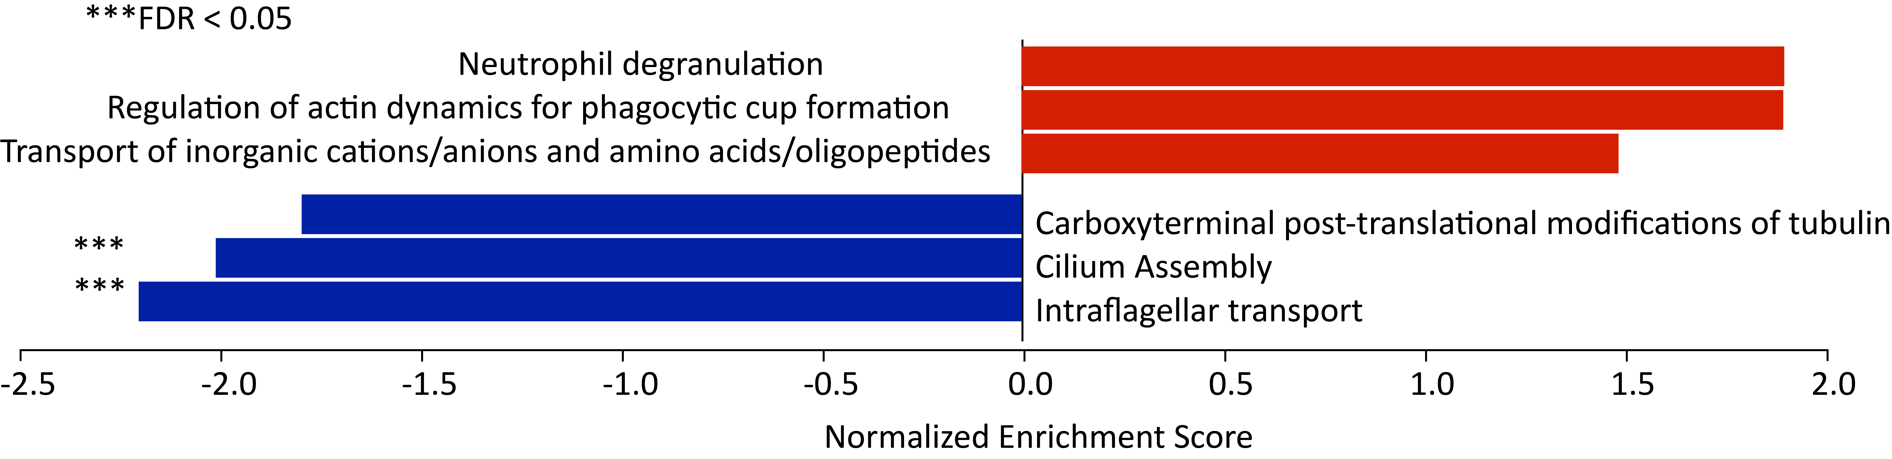
SARS-CoV-2 metagenomics for identification of microbial superinfection
Joshua D. Bloomstein¹, Eran Mick^{2,3}, Alexandra Tsitsiklis^{2,3}, Charles R. Langelier^{2,3}
¹University of California, Davis School of Medicine
²Chan Zuckerberg Biohub
³Division of Infectious Diseases, University of California, San Francisco
Background
u
Delta variant vs. other variants differential expression
z
Patient NS-TA abundance correlation
SARS-CoV-2 superinfection can masquerade as COVID-19 flare or non-infectious ARDS
No method of diagnosis of bacterial pneumonia exists for non-intubated patients
Lower respiratory culture results in ~1 week and not all pathogens can be cultured
Differential diagnoses have contradictory treatments
We aimed to compare host transcriptomics of Delta variant versus other variants
We aimed to characterize microbiome of upper and lower airway in patients with COVID-19 with concurrent ventilator-associated pneumonia (COVID-VAP)
Row z score
- Delta
- Mutation
Results
Bulk RNA-seq of Delta variant versus other variants showed 49 differentially expressed genes (DEG)s at threshold of 5-fold change and FDR < 0.05 u
Gene Set Enrichment Analysis (GSEA) highlighted downregulation of flagellar transport and possible upregulation of neutrophil degranulation v
α-diversity and β-diversity did not significantly differ between NS and TA samples w, x
In COVID-VAP, nasal swab microbiome correlates with tracheal aspirate microbiome y, z
w
y
Conclusions
Delta variant generates a unique host response most likely implicated in its enhanced virulence
NS serves as surrogate for TA in COVID-VAP
Metagenomics show promise as a method for rapid detection of COVID superinfection
x
Future Steps
Bray-Curtis permanova
p = 0.06
Calculate Spearman rank-order correlation of established respiratory pathogens between NS and TA samples
Identify NS host gene signature to rapidly predict bacterial or fungal superinfection
Compare host response of symptomatic versus asymptomatic patients with positive SARS-CoV-2 test
Determine the utility of NS for predicting antibiotic resistance in COVID-VAP
v
Delta vs. other variants GSEA

